Slide 1
MULTIPLE LINEAR REGRESSION – FAMA FRENCH 3 FACTOR MODEL
AZIM KACHWALLA
BIN LU
LEAH CHANCE
SIWEI CHEN
TAMANNA SINHA

Slide 2
Table of contents
Problem Statement
Fama French Model
Description of Data
Hypotheses
Results and Conclusions

Slide 3
Problem Statement
In this project our goals are to:
Test if the Fama French Three Factor Model is accurate in describing stock returns in selected portfolios.
Since we are dealing with a large timespan(1960-2019) we expect some of the coefficients to change in the model as the market changes. Therefore, we would like to prove this claim.

Slide 4
Fama French Model
Developed by Eugene Fama and Kenneth French
Describes stock returns in asset pricing and portfolio management.
Expands on the capital asset pricing model by adding size risk and value risk factors to the market risk factor.
The Model formula is as follows:

Slide 5
Fama French Model
Contains three factors:
Size of firms - SMB (Small Minus Big)
Book-to-market values - HML (High Minus Low)
Excess return on the market - (portfolios return less the risk free rate of return)

Slide 6
Description of Data used
The data for our experiment was obtained from the Kenneth and Fama website.
Description of portfolios formed on size:
Portfolios are constructed at the end of each June using market equity and NYSE breakpoints.
The portfolios for July of year t to June of t+ 1 include all NYSE, AMEX and NASDAQ stocks for which we have market equity for June of t.
For our project we consider the Decile portfolios.

Slide 7
Description of Data Used
2. Description of Fama French Factors:
SMB (Small Minus Big) is the average return on the three small portfolios minus the average return on the three big portfolios
HML (High Minus Low) is the average return on the two value portfolios minus the average return on the two growth portfolios.
Rm-Rf the excess return on the market, value-weight return of all CRSP firms incorporated in the US and listed on the NYSE, AMEX or NASDAQ

Slide 8

First Hypothesis
Our hypothesis is setup as follows:
The programing language R was used to perform the Fama French regression to fit the model to the data and to calculate the values.
If we do not reject the null hypothesis, it indicates that the Fama French Model is a good fit for the prediction. However, if we reject the null hypothesis , it means that the model is not a good fit for the data.

Slide 9
Missing Values
We test our model with missing data
To test this case, we randomly replace 20% of the data in the portfolio files and the Fama French model with N/A.
From there, we once again perform multivariate regression on our data.

Slide 10
RESULTS
We try to observe the following in our hypothesis:
Effects of Missing values on the coefficients of Fama French Model.
Coefficients for the factors along with the intercept.
99% confidence intervals and the p values.
Plot of coefficients along with confidence interval.
QQ Plot

Slide 11
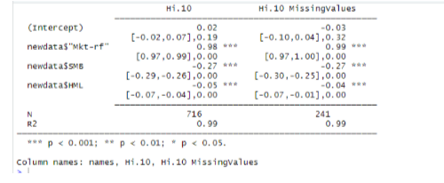
Hi 10

Slide 12
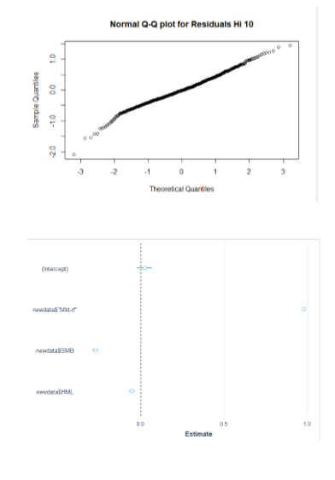

Slide 13
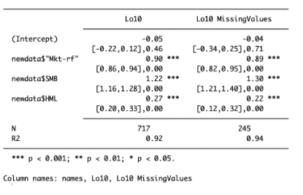
RESULTS
LO10

Slide 14
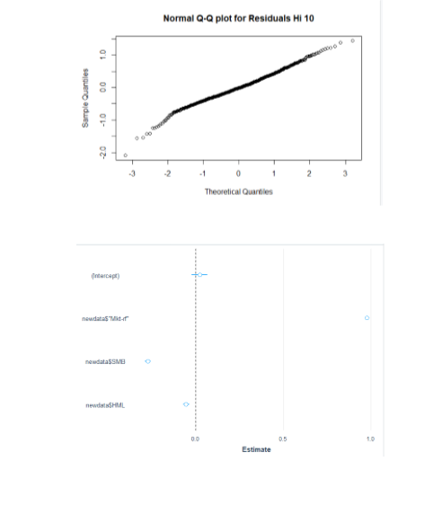

Slide 15
Results for Hypothesis A
From our observations, the variable “constant” refers to our alpha, which indeed is equal to zero for all of our 10 portfolios.
Therefore, we do not reject the null Hypothesis and conclude that the Fama French model is a good fit for our data.
All our QQ Plots show that our data follows normal distribution

Slide 16
Missing Value Analysis
From our observations, we can conclude that missing values does not cause a significant difference in our regression results.
We obtained similar coefficients, R square and constant value for both linear regression with and without missing values.

Slide 17
Second Hypothesis
From the timespan of 1960-2019, do the coefficients in the model change or remain the same?
To determine this, we split our data in half until 1990.
We consider an indicator variable which splits our data into two sets. The first set is for t <= 1990 and the second set is for t > 1990.
Now our Regression equation changes to:

Slide 18

Second Hypothesis Cont.
Our Hypothesis is as follows:
If we do not reject the null hypothesis- no significant change in coefficients.
If we reject the null hypothesis - there has been a change in the coefficients.

Slide 19
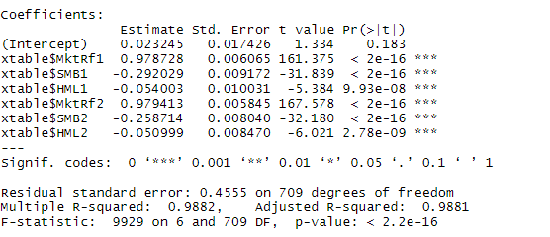
RESULTS
HI 10

Slide 20
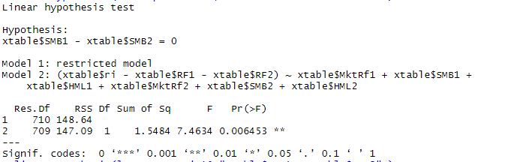

Slide 21
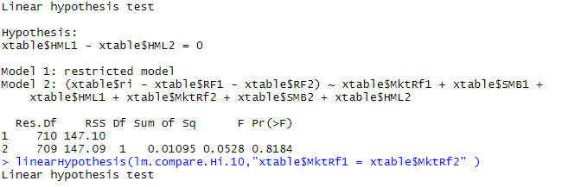

Slide 22
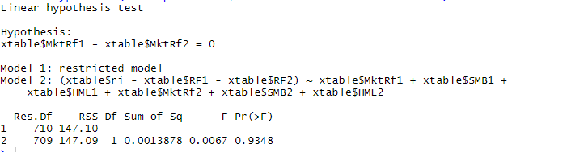

Slide 23
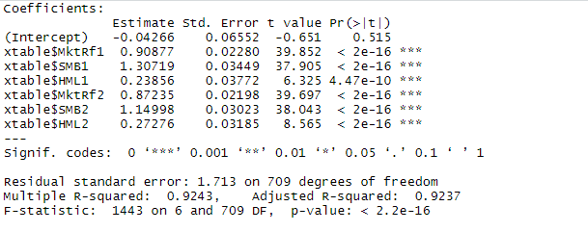
LO 10

Slide 24
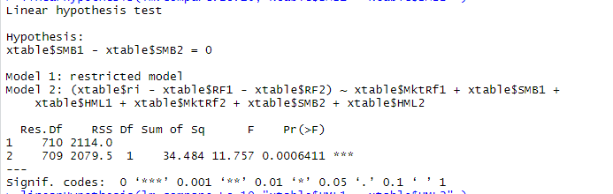

Slide 25
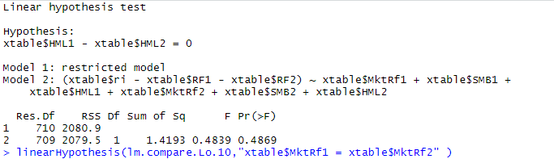

Slide 26
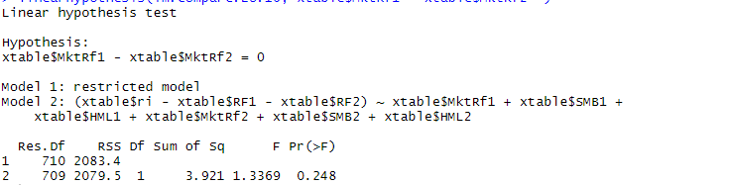

Slide 27
Results for Hypothesis B
Each coefficient of factors smb, hml, mktrf have been tested for the two periods for all 10 portfolios.
If there is a *** against the value of (Pr>F), it indicates, significant change in market for that factor and reject the null hypothesis.

Slide 28
CONCLUSION
HYPOTHESIS A - We see from the observations, the variable “Constant” refers to our i, is equal to zero for all our 10 portfolios. This implies that we do not reject the null hypothesis and conclude that the Fama French 3 factor model is a good fit for our data.
HYPOTHESIS B - We see from the observations, that for coefficients of each factor and the portfolios we get a different result.
MISSING VALUES - We see from the observations, that missing value doesn’t bring significant difference for our regression results. We got similar coefficient, R square and constant value for both linear regression with and without missing values.

Slide 29
Thank You

Slide 30
R Code
install.packages('stargazer')
install.packages("huxtable")
install.packages("car")
install.packages("broom")
install.packages('tidyquant')
install.packages("jtools")
install.packages("ggstance")
install.packages('tidyverse')
library('stargazer')
library('tidyquant')
library(tidyverse)
install.packages("ggplot2")
library('ggplot2')
library('jtools')
library('broom')
library("carData")
library(ggstance)
library(car)
library(huxtable)

Slide 31
R Code
###function fama regression
test<-function(fama,ri){
newdata<-cbind(fama,ri)
colnames(newdata)<- c("Date","Mkt-rf","SMB","HML","RF","Ri")
return(lm((newdata$Ri-newdata$RF) ~ newdata$'Mkt-rf' +newdata$SMB + newdata$HML))
}
###function compare before and after data
fama.compare<-function(fama1,fama2,ri){
xtable<-cbind(fama1,fama2,ri)
colnames(xtable)<- c('Date1','MktRf1','SMB1','HML1','RF1','Date2','MktRf2','SMB2','HML2','RF2','ri')
lm.compare<-lm((xtable$ri-xtable$RF1-xtable$RF2)~xtable$MktRf1+xtable$SMB1+xtable$HML1+xtable$MktRf2+xtable$SMB2+xtable$HML2)
return(lm.compare)
}

Slide 32
R Code
### function generate NA in data frame
gene.NA<-function(data){
fama.NA<-data
n<-dim(fama.NA)[1]
i=1
while (i <= dim(fama.NA)[2]) {
random1<-sample(1:n,ceiling(0.2*n),replace = F)
fama.NA[random1, i]<-rep(NA,ceiling(0.2*n))
i=i+1
}
return(fama.NA)
}
###data used for test
colnames(fama)[1]<-c('Date')
fama.after<-fama
fama.after[which(fama.after$Date<199001),]<-0
fama.before<-fama
fama.before[which(fama.before$Date>=199001),]<-0
fama.NA<-gene.NA(fama)
data.NA<-gene.NA(data)

Slide 33
R Code
#Lo.10
lm.total.Lo.10<-test(fama,data[,2])
lm.NA.Lo.10<-test(fama.NA,data.NA[,2])
lm.compare.Lo.10<-fama.compare(fama.before,fama.after,data[,2])
#Plots
qqnorm(lm.total.Lo.10$residuals, main = "Normal Q-Q plot for Residuals Lo10")
qqline(lm.total.Lo.10)
plot_coefs(lm.total.Lo.10,ci_level = 0.99,omit.coefs = NULL)
#Compare Results
export_summs(lm.total.Lo.10,lm.NA.Lo.10,error_format = "[{conf.low},{conf.high}],{p.value}",ci_level = 0.99,model.names = c("Lo10","Lo10 MissingValues"))
summary(lm.compare.Lo.10)
linearHypothesis(lm.compare.Lo.10,"xtable$SMB1 = xtable$SMB2" )
linearHypothesis(lm.compare.Lo.10,"xtable$HML1 = xtable$HML2" )
linearHypothesis(lm.compare.Lo.10,"xtable$MktRf1 = xtable$MktRf2" )

Slide 34
R Code
#X2.Dec
lm.total.X2.Dec<-test(fama,data[,3])
lm.NA.X2.Dec<-test(fama.NA,data.NA[,3])
lm.compare.X2.Dec<-fama.compare(fama.before,fama.after,data[,3])
#Plots
qqnorm(lm.total.X2.Dec$residuals, main = "Normal Q-Q plot for Residuals X2.Dec")
qqline(lm.total.X2.Dec$residuals)
plot_coefs(lm.total.X2.Dec,ci_level = 0.99,omit.coefs = NULL)
#Compare Results
export_summs(lm.total.X2.Dec,lm.NA.X2.Dec,error_format = "[{conf.low},{conf.high}],{p.value}",ci_level = 0.99,model.names = c("X2.Dec","X2.Dec MissingValues"))
summary(lm.total.X2.Dec)
linearHypothesis(lm.compare.X2.Dec,"xtable$SMB1 = xtable$SMB2" )
linearHypothesis(lm.compare.X2.Dec,"xtable$HML1 = xtable$HML2" )
linearHypothesis(lm.compare.X2.Dec,"xtable$MktRf1 = xtable$MktRf2" )

Slide 35
R Code
#X3.Dec
lm.compare.X3.Dec<-fama.compare(fama.before,fama.after,data[,4])
lm.total.X3.Dec<-test(fama,data[,4])
lm.NA.X3.Dec<-test(fama.NA,data.NA[,4])
qqnorm(lm.total.X3.Dec$residuals, main = "Normal Q-Q plot for Residuals X3.Dec" )
qqline(lm.total.X3.Dec$residuals)
plot_coefs(lm.total.X3.Dec,ci_level = 0.99,omit.coefs = NULL)
export_summs(lm.total.X3.Dec,lm.NA.X3.Dec,error_format = "[{conf.low},{conf.high}],{p.value}",ci_level = 0.99,model.names = c("X3.Dec","X3.Dec MissingValues"))
summary(lm.compare.X3.Dec)
linearHypothesis(lm.compare.X3.Dec,"xtable$SMB1 = xtable$SMB2" )
linearHypothesis(lm.compare.X3.Dec,"xtable$HML1 = xtable$HML2" )
linearHypothesis(lm.compare.X3.Dec,"xtable$MktRf1 = xtable$MktRf2" )

Slide 36
R Code
#X4.Dec
lm.total.X4.Dec<-test(fama,data[,5])
lm.NA.X4.Dec<-test(fama.NA,data.NA[,5])
lm.compare.X4.Dec<-fama.compare(fama.before,fama.after,data[,5])
qqnorm(lm.total.X4.Dec$residuals, main = "Normal Q-Q plot for Residuals X4.Dec" )
qqline(lm.total.X4.Dec$residuals)
plot_coefs(lm.total.X4.Dec,ci_level = 0.99,omit.coefs = NULL)
export_summs(lm.total.X4.Dec,lm.NA.X4.Dec,error_format = "[{conf.low},{conf.high}],{p.value}",ci_level = 0.99,model.names = c("X4.Dec","X4.Dec MissingValues"))
summary(lm.compare.X4.Dec)
linearHypothesis(lm.compare.X4.Dec,"xtable$SMB1 = xtable$SMB2" )
linearHypothesis(lm.compare.X4.Dec,"xtable$HML1 = xtable$HML2" )
linearHypothesis(lm.compare.X4.Dec,"xtable$MktRf1 = xtable$MktRf2" )

Slide 37
R Code
#X5.Dec
lm.total.X5.Dec<-test(fama,data[,6])
lm.NA.X5.Dec<-test(fama.NA,data.NA[,6])
lm.compare.X5.Dec<-fama.compare(fama.before,fama.after,data[,6])
qqnorm(lm.total.X5.Dec$residuals, main = "Normal Q-Q plot for Residuals X5.Dec" )
qqline(lm.total.X5.Dec$residuals)
plot_coefs(lm.total.X5.Dec,ci_level = 0.99,omit.coefs = NULL)
export_summs(lm.total.X5.Dec,lm.NA.X5.Dec,error_format = "[{conf.low},{conf.high}],{p.value}",ci_level = 0.99,model.names = c("X5.Dec","X5.Dec MissingValues"))
summary(lm.compare.X5.Dec)
linearHypothesis(lm.compare.X5.Dec,"xtable$SMB1 = xtable$SMB2" )
linearHypothesis(lm.compare.X5.Dec,"xtable$HML1 = xtable$HML2" )
linearHypothesis(lm.compare.X5.Dec,"xtable$MktRf1 = xtable$MktRf2" )

Slide 38
R Code
#X6.Dec
lm.total.X6.Dec<-test(fama,data[,7])
lm.NA.X6.Dec<-test(fama.NA,data.NA[,7])
lm.compare.X6.Dec<-fama.compare(fama.before,fama.after,data[,7])
qqnorm(lm.total.X6.Dec$residuals, main = "Normal Q-Q plot for Residuals X6.Dec" )
qqline(lm.total.X6.Dec$residuals)
plot_coefs(lm.total.X6.Dec,ci_level = 0.99,omit.coefs = NULL)
summary(lm.compare.X6.Dec)
linearHypothesis(lm.compare.X6.Dec,"xtable$SMB1 = xtable$SMB2" )
linearHypothesis(lm.compare.X6.Dec,"xtable$HML1 = xtable$HML2" )
linearHypothesis(lm.compare.X6.Dec,"xtable$MktRf1 = xtable$MktRf2" )

Slide 39
R Code
#X7.Dec
lm.total.X7.Dec<-test(fama,data[,8])
lm.NA.X7.Dec<-test(fama.NA,data.NA[,8])
lm.compare.X7.Dec<-fama.compare(fama.before,fama.after,data[,8])
qqnorm(lm.total.X7.Dec$residuals, main = "Normal Q-Q plot for Residuals X7.Dec" )
qqline(lm.total.X7.Dec$residuals)
plot_coefs(lm.total.X7.Dec,ci_level = 0.99,omit.coefs = NULL)
export_summs(lm.total.X7.Dec,lm.NA.X7.Dec,error_format = "[{conf.low},{conf.high}],{p.value}",ci_level = 0.99,model.names = c("X7.Dec","X7.Dec MissingValues"))
summary(lm.compare.X7.Dec)
linearHypothesis(lm.compare.X7.Dec,"xtable$SMB1 = xtable$SMB2" )
linearHypothesis(lm.compare.X7.Dec,"xtable$HML1 = xtable$HML2" )
linearHypothesis(lm.compare.X7.Dec,"xtable$MktRf1 = xtable$MktRf2" )

Slide 40
R Code
#X8.Dec
lm.total.X8.Dec<-test(fama,data[,9])
lm.NA.X8.Dec<-test(fama.NA,data.Na[,9])
lm.compare.X8.Dec<-fama.compare(fama.before,fama.after,data[,9])
qqnorm(lm.total.X8.Dec$residuals, main = "Normal Q-Q plot for Residuals X8.Dec" )
qqline(lm.total.X8.Dec$residuals)
plot_coefs(lm.total.X8.Dec,ci_level = 0.99,omit.coefs = NULL)
export_summs(lm.total.X8.Dec,lm.NA.X8.Dec,error_format = "[{conf.low},{conf.high}],{p.value}",ci_level = 0.99,model.names = c("X8.Dec","X8.Dec MissingValues"))
summary(lm.compare.X8.Dec)
linearHypothesis(lm.compare.X8.Dec,"xtable$SMB1 = xtable$SMB2" )
linearHypothesis(lm.compare.X8.Dec,"xtable$HML1 = xtable$HML2" )
linearHypothesis(lm.compare.X8.Dec,"xtable$MktRf1 = xtable$MktRf2" )

Slide 41
R Code
#X9.Dec
lm.total.X9.Dec<-test(fama,data[,9])
lm.NA.X9.Dec<-test(fama.NA,data[,9])
lm.compare.X9.Dec<-fama.compare(fama.before,fama.after,data[,10])
qqnorm(lm.total.X9.Dec$residuals, main = "Normal Q-Q plot for Residuals X6.Dec" )
qqline(lm.total.X9.Dec$residuals)
plot_coefs(lm.total.X9.Dec,ci_level = 0.99,omit.coefs = NULL)
export_summs(lm.total.X9.Dec,lm.NA.X9.Dec,error_format = "[{conf.low},{conf.high}],{p.value}",ci_level = 0.99,model.names = c("X9.Dec","X9.Dec MissingValues"))
summary(lm.compare.X9.Dec)
linearHypothesis(lm.compare.X9.Dec,"xtable$SMB1 = xtable$SMB2" )
linearHypothesis(lm.compare.X9.Dec,"xtable$HML1 = xtable$HML2" )
linearHypothesis(lm.compare.X9.Dec,"xtable$MktRf1 = xtable$MktRf2" )

Slide 42
R Code
#Hi.10
lm.total.Hi.10<-test(fama,data[,11])
lm.NA.Hi.10<-test(fama.NA,data.NA[,11])
lm.compare.Hi.10<-fama.compare(fama.before,fama.after,data[,11])
qqnorm(lm.total.Hi.10$residuals, main = "Normal Q-Q plot for Residuals X6.Dec" )
qqline(lm.total.Hi.10$residuals)
plot_coefs(lm.total.Hi.10,ci_level = 0.99,omit.coefs = NULL)
export_summs(lm.total.Hi.10,lm.NA.Hi.10,error_format = "[{conf.low},{conf.high}],{p.value}",ci_level = 0.99,model.names = c("Hi.10","Hi.10 MissingValues"))
summary(lm.compare.Hi.10)
linearHypothesis(lm.compare.Hi.10,"xtable$SMB1 = xtable$SMB2" )
linearHypothesis(lm.compare.Hi.10,"xtable$HML1 = xtable$HML2" )
linearHypothesis(lm.compare.Hi.10,"xtable$MktRf1 = xtable$MktRf2" )

